Slide 1
The Common Core
State Standards

Slide 2

Why Do We Need the
Common Core Standards?

Slide 3
The Challenge: Too Few U.S. Workers Have the Skills Needed in Today’s Economy
In the 21st century global marketplace, a nation’s economy can only be as strong as the skills of its people. Due to the changing global economy, workers’ skills do not match what business and industry now need.
The McKinsey Global Institute estimates that the U.S. could be short as many as 1.5 million college graduates by 2020. This could mean losing our current lead in areas that give us an edge in business and engineering innovation.

Slide 4
The Challenge: Too Few U.S. Workers Have the Skills Needed in Today’s Economy
As baby-boomers retire, U.S. manufacturing faces a deficit of skilled workers, ranging from university-educated aerospace engineers to community college-trained precision machinists.
We have a persistent unmet demand of 400,000-500,000 jobs openings in the healthcare industry, a higher rate than in other service industries, many of which could be filled by training workers in community colleges

Slide 5
The Challenge: Too Few U.S. Workers Have the Skills Needed in Today’s Economy
What the skills gap really means is that even in the current jobs crisis, jobs are going unfilled today partly because employers can’t find workers with the appropriate skills.

Slide 6
The Challenge: Too Few U.S. Workers Have the Skills Needed in Today’s Economy
What the skills gap really means is that even in the current jobs crisis, jobs are going unfilled today partly because employers can’t find workers with the appropriate skills.

Slide 7
The Challenge: Too Few U.S. Workers Have the Skills Needed in Today’s Economy
What the skills gap really means is that even in the current jobs crisis, jobs are going unfilled today partly because employers can’t find workers with the appropriate skills.

Slide 8
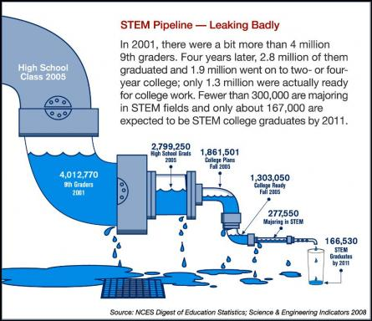
Why Do We Need the
Common Core Standards?
2001
4,000,000 9th graders:
If 2.8 million students graduated from college in 2005, then that means 1.2 million of those students dropped out of school.

Slide 9
Why Do We Need the
Common Core Standards?
The development of the standards was driven by the concern over the deficit of highly-skilled workers.
The unemployment figure is 8.9 percent for college graduates with bachelor degrees, 22.9 percent for high school graduates and 31.5 percent for high school dropouts.
STEM (science, technology, engineering and mathematics) jobs to rise from 6.8 million in 2008 to 8 million by 2018.
“America’s education system is basically a 19th century model that is not preparing enough students to be successful in the 21st century economy” leaving “over two million unfilled, high wage and high-skilled jobs.”

Slide 10
The Common Core Standards
The Common Core State Standards describe the knowledge and skills in English Language Arts and Mathematics that students will need when they graduate, whatever their choice of college or career.
The standards define the knowledge and skills students should have to succeed in entry-level, credit-bearing, academic college courses and in workforce training programs.
The standards are based on the best national and international standards, giving our students a competitive advantage in the global economy. This state-led effort is coordinated by the National Governors Association Center for Best Practices (NGA Center) and the Council of Chief State School Officers (CCSSO).

Slide 11
The Common Core Standards
State led effort to develop a curriculum that ensures US students are competitive in the global marketplace.
Benchmarked to International standards.
Provide clear and consistent standards of what students should know and be able to do.
Ensure that all students have the opportunity to engage in equally challenging work.

Slide 12
Common Core State Standards

Slide 13
How are teachers being prepared for the changing standards?
In 2011 – 12, three days were dedicated to Common Core and Essential Standards professional development in Haywood County.
In 2012 – 13, three days additional days have been dedicated to Common Core and Essential Standards professional development in Haywood County
Schools provide teachers time to learn about the standards and prepare for implementation that has begun this year.
Additional training was offered this summer.

Slide 14
How can you be an advocate for your child?
Maintain communication with your child’s teacher and school.
Be an active participant in school-wide activities (PTA meetings, open houses, parent-teacher conferences, etc.).
Know the expectations of the standards.
Ensure supports are in place for student learning both at home and at school.

Slide 15
Where can I find more information?
Common Core State Standards Initiative– http://www.corestandards.org
North Carolina Department of Public Instruction (NCDPI)- http://ncpublicschools.org/acre/standards
Your child’s teacher
National Parent Teacher Association( PTA) Parent’s Guide to Success– http://pta.org/4446.htm

