Slide 1
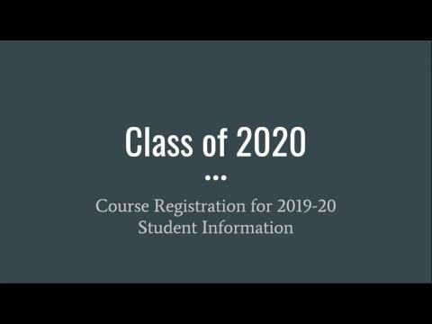
Class of 2020
Course Registration for 2019-20
Student Information

Slide 2

It’s time to choose your classes for your SENIOR YEAR!!! Can you believe it?

Slide 3

What’s NEW and DIFFERENT?
County-Wide change in Honors Criteria
(New criteria is in effect for Fall 2019 and beyond)
Level 4 or 5 in Previous Course (A if NCFE, VoCat, or Teacher-Made Exam)
OR
90 or Higher Average in Regular Course/85 or Higher Average in Honors Course
OR
School Recommendation (Teacher Input, EVAAS, Previous Grades, Previous Test Scores to include PreACT and ACT, AIG, etc.)

Slide 4
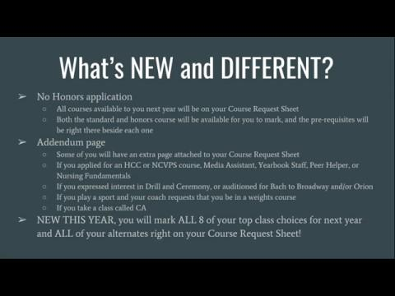
What’s NEW and DIFFERENT?
No Honors application
  All courses available to you next year will be on your Course Request Sheet
  Both the standard and honors course will be available for you to mark, and the pre-requisites will be right there beside each one
Addendum page
  Some of you will have an extra page attached to your Course Request Sheet
  If you applied for an HCC or NCVPS course, Media Assistant, Yearbook Staff, Peer Helper, or Nursing Fundamentals
  If you expressed interest in Drill and Ceremony, or auditioned for Bach to Broadway and/or Orion
  If you play a sport and your coach requests that you be in a weights course
  If you take a class called CA
NEW THIS YEAR, you will mark ALL 8 of your top class choices for next year and ALL of your alternates right on your Course Request Sheet!

Slide 5
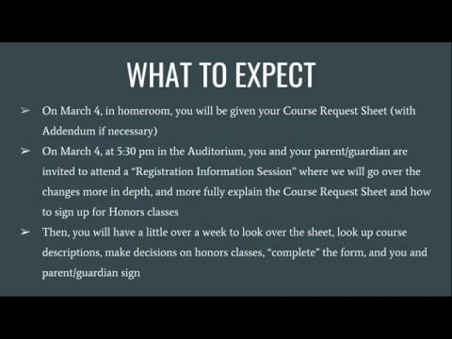
WHAT TO EXPECT
On March 4, in homeroom, you will be given your Course Request Sheet (with Addendum if necessary)
On March 4, from 3:00pm to 6:00pm, guidance counselors will be available to answer questions in the guidance center for those needing additional assistance.
Then, you will have a little over a week to look over the sheet, look up course descriptions, make decisions on honors classes, “complete” the form, and you and parent/guardian sign.
Notes:
So…..what comes next? On March 4 you will be given your Course Request Sheet, and Addendum, if applicable. Want more information on completing the sheet and how you request honors courses? There will be a Registration Information session at 5:30 on March 4 for you and parents where we can answer any questions you may have. Then, you will have a little over a week to decide on and mark all of your classes. Read the directions, know what all has to be done for your form to be considered complete!

Slide 6
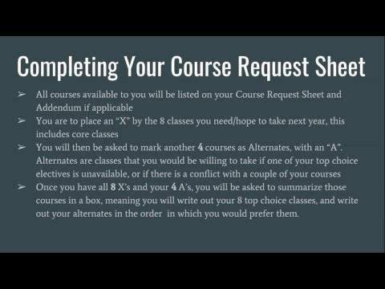
Completing Your Course Request Sheet
All courses available to you will be listed on your Course Request Sheet and Addendum if applicable
You are to place an “X” by the 8 classes you need/hope to take next year, this includes core classes
You will then be asked to mark another 4 courses as Alternates, with an “A”. Alternates are classes that you would be willing to take if one of your top choice electives is unavailable, or if there is a conflict with a couple of your courses
Once you have all 8 X’s and your 4 A’s, you will be asked to summarize those courses in a box, meaning you will write out your 8 top choice classes, and write out your alternates in the order in which you would prefer them.

Slide 7
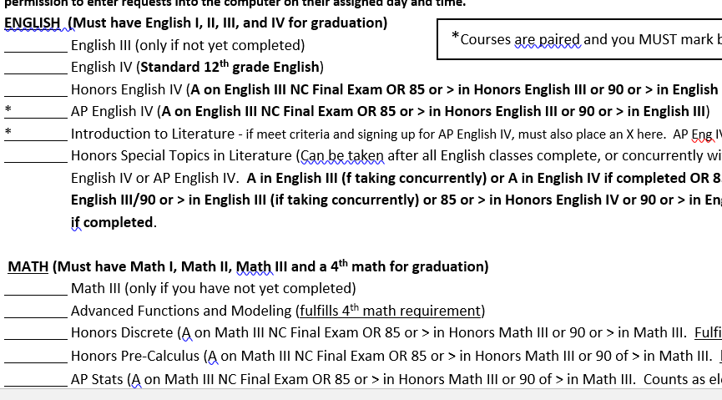
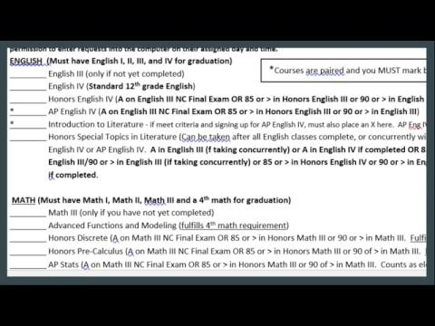

Slide 8
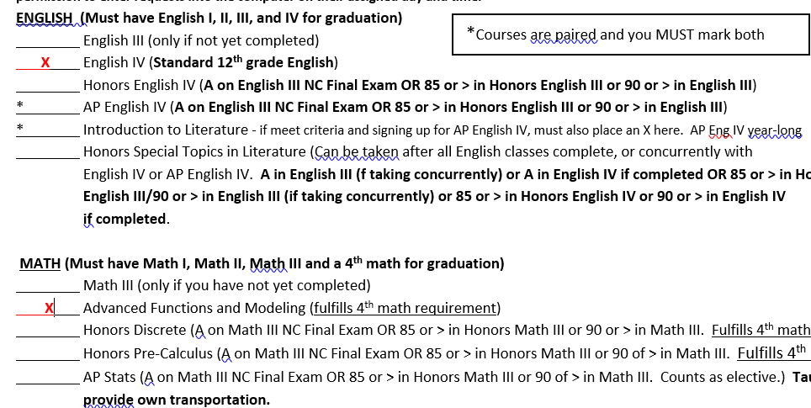
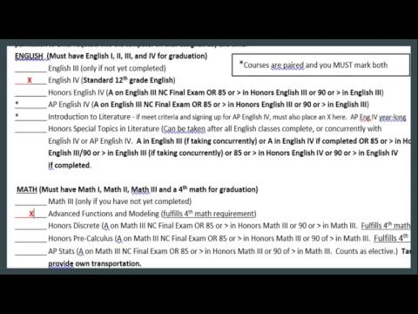

Slide 9
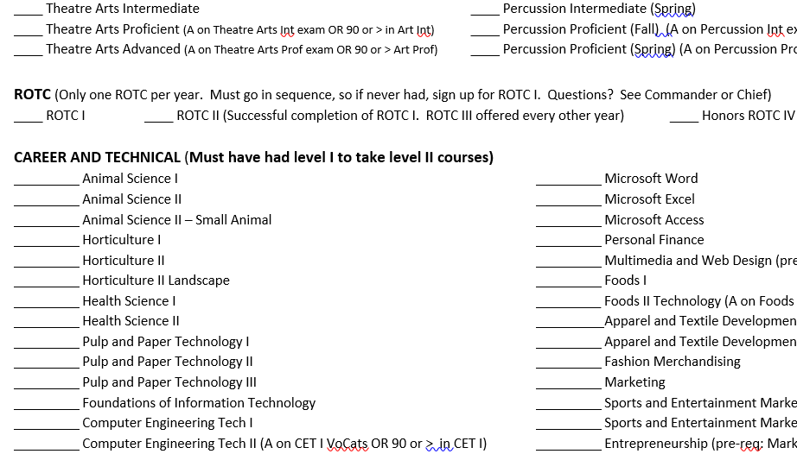
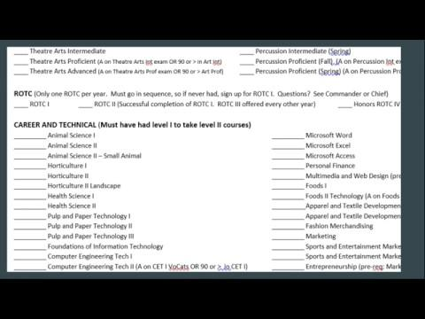

Slide 10
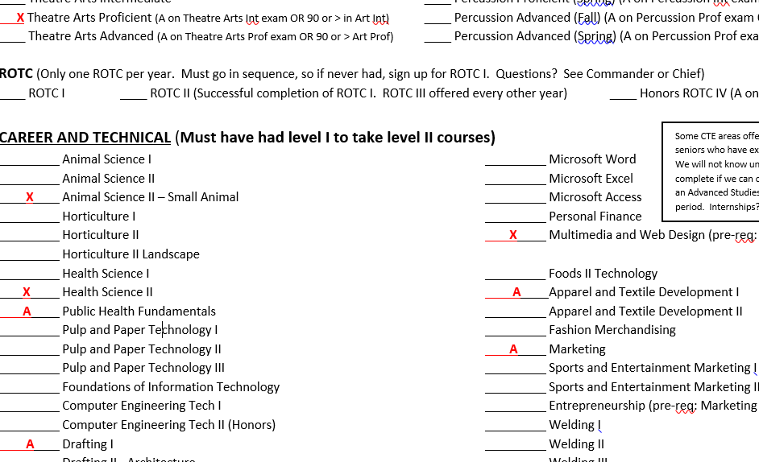
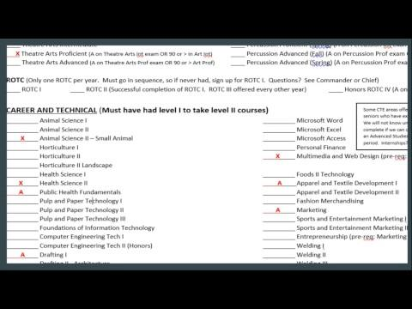

Slide 11
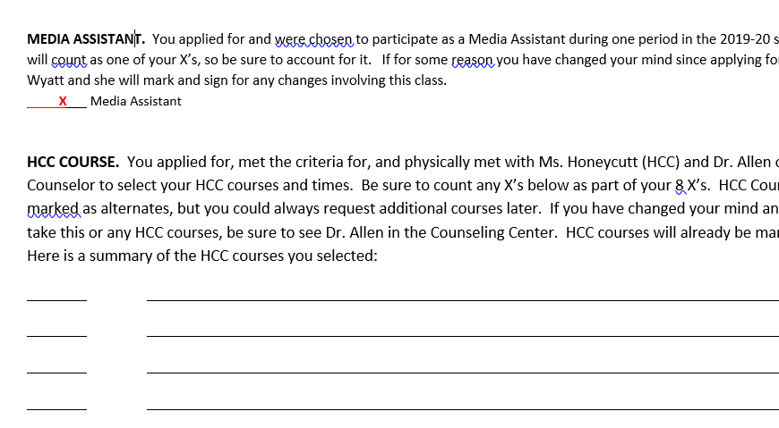
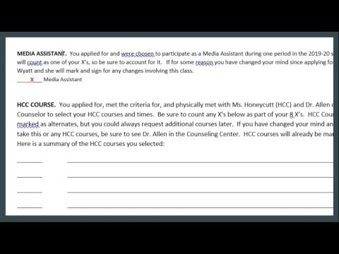

Slide 12
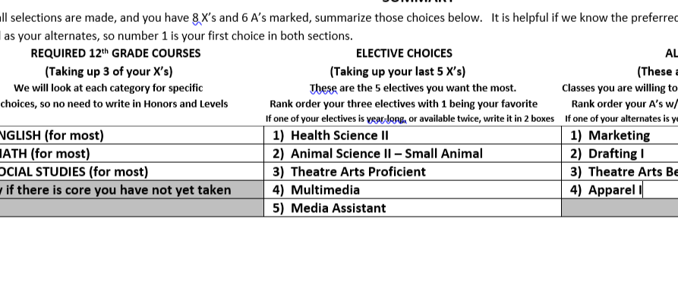
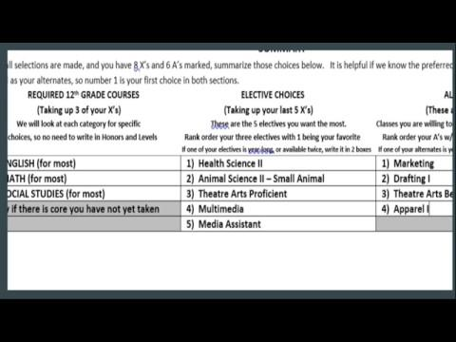

Slide 13
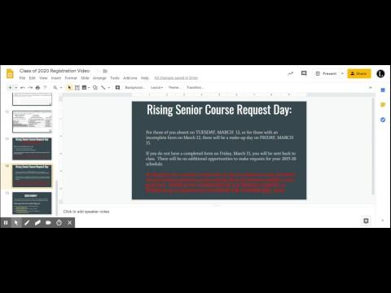
Rising Senior Course Request Day: TUESDAY, MARCH 12
When you arrive in the Media Center , we will:
Check to see if you have 8 X’s and 4 A’s
Check to see if you and parent have signed form
If you have sheet marked completely, and signatures are there, you will go into a lab to enter your requests!
If you do not have your form COMPLETELY FILLED OUT, or if you and parent have not signed, YOU WILL BE SENT BACK TO CLASS without entering requests

Slide 14
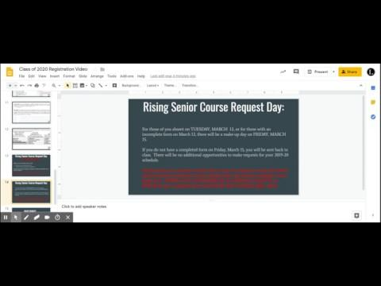
Rising Senior Course Request Day:
For those of you absent on TUESDAY, MARCH 12, or for those with an incomplete form on March 12, there will be a make-up day on FRIDAY, MARCH 15.
If you do not have a completed form on Friday, March 15, you will be sent back to class. There will be no additional opportunities to make requests for your 2019-20 schedule.
At this point, your counselor would enter in any core classes you need and choose electives based on electives you have already taken and electives available to your grade level. THERE IS NO GUARANTEE OF A SCHEDULE CHANGE, so PLEASE bring a completed form and ENTER THE COURSES YOU want!!

Slide 15
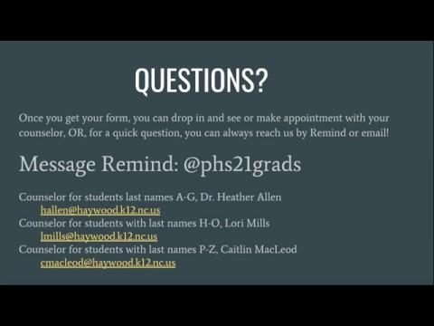
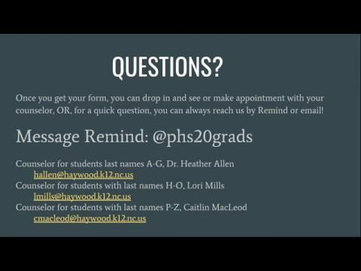
QUESTIONS?
Once you get your form, you can drop in and see or make appointment with your counselor, OR, for a quick question, you can always reach us by Remind or email!
Message Remind: @phs20grads
Counselor for students last names A-G, Dr. Heather Allen
hallen@haywood.k12.nc.us
Counselor for students with last names H-O, Lori Mills
lmills@haywood.k12.nc.us
Counselor for students with last names P-Z, Caitlin MacLeod
cmacleod@haywood.k12.nc.us

