Slide 1
Pisgah High School Math ACT
Preparing for the Math on the ACT!
Mrs. K. Sorrells

Slide 2
Calculators:
Calculators will be provided for you in the classrooms you are testing in. However, they could be scientific calculators, TI-83s, and TI-84s.
You may bring your own.
DO NOT try and use them on every question on the test or you will run out of time!

Slide 3
Timing:
60 Minutes to do 60 Questions!!
Use your time wisely. Pace yourself!!
Problems are mostly in order with the first third being the easiest, the last third being the hardest, and the one in the middle being middle of the road. That is NOT saying the first problem is the easiest and the last problem the hardest!
Use the “Two Pass” method.

Slide 4
Pass One
Work problems you know how to work and can work quickly.
Work problems you do not need a calculator for.
Look for relationships!
Skip problems you are confused on or will take extra time.

Slide 5
Pass Two:
Working the problems you skipped.
Try to eliminate answers.
If you cannot work a problem at all, then guess. But mark that you guessed on the test book so you can go back if time allows.
If you are randomly guessing, pick one letter and stick with it on all random guesses.
All questions weigh equally!

Slide 6
Read The Question Carefully!
Read each question carefully.
Thank about what it is asking for.
THINK!!!!!
At 5 Minutes Warning, guess on all the rest picking one letter!

Slide 7
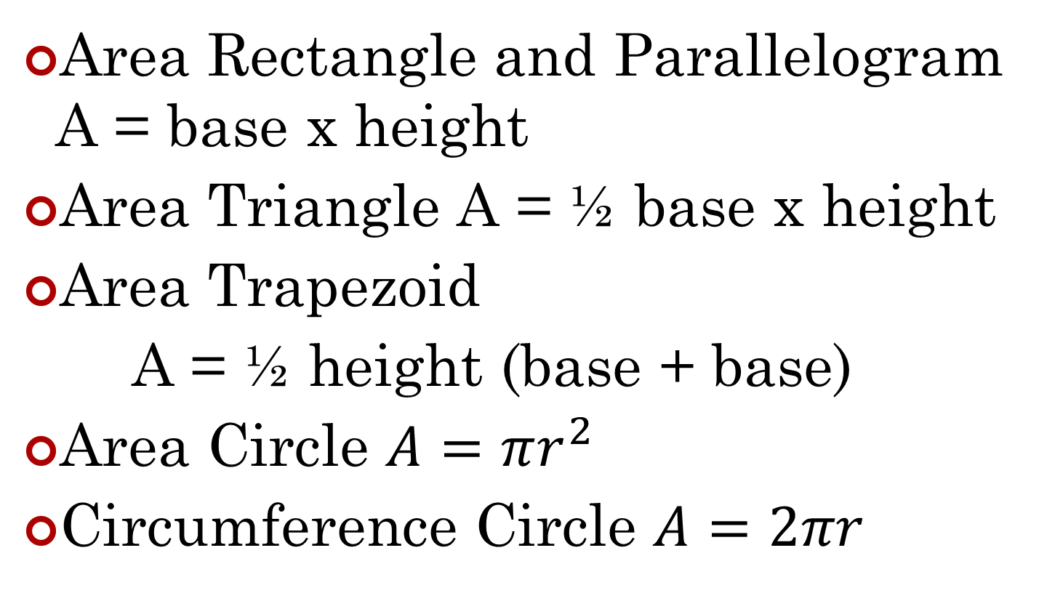
Formulas
Area Rectangle and Parallelogram A = base x height
Area Triangle A = ½ base x height
Area Trapezoid
A = ½ height (base + base)
Area Circle $A=πr^{2}$
Circumference Circle $A=2πr$

Slide 8
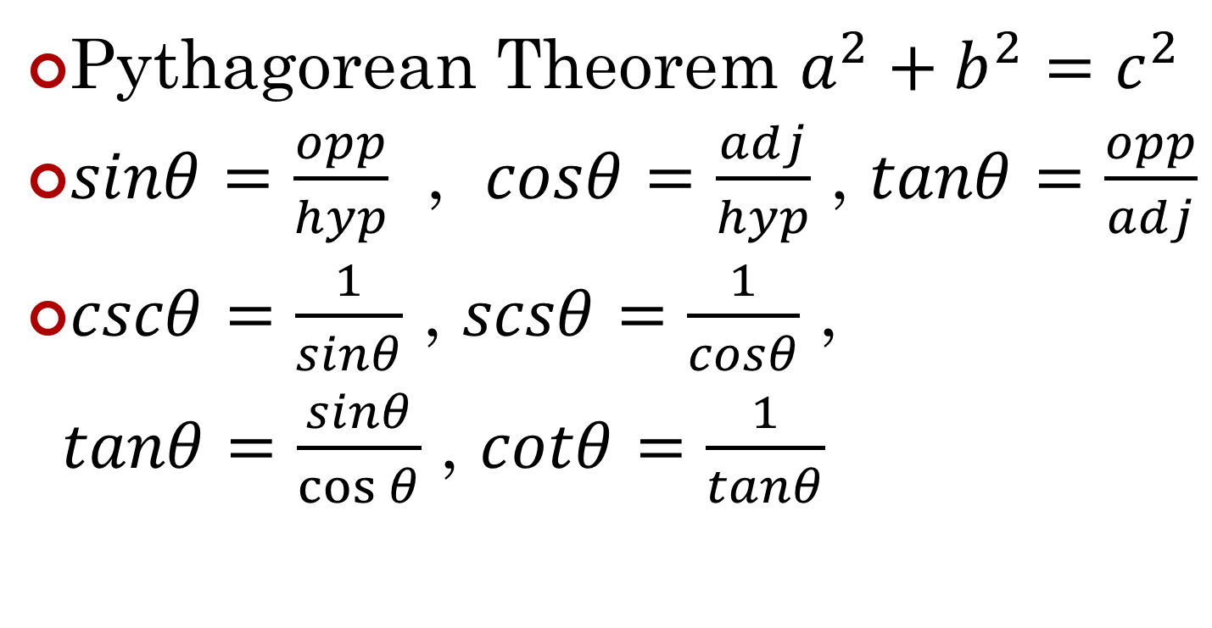
Right Triangle Formulas
Pythagorean Theorem $a^{2}+b^{2}=c^{2}$
$sinθ=\frac{opp}{hyp}$ , $cosθ=\frac{adj}{hyp}$ , $tanθ=\frac{opp}{adj}$
$cscθ=\frac{1}{sinθ}$ , $scsθ=\frac{1}{cosθ}$ ,
$tanθ=\frac{sinθ}{\cos{θ}}$ , $cotθ=\frac{1}{tanθ}$

Slide 9
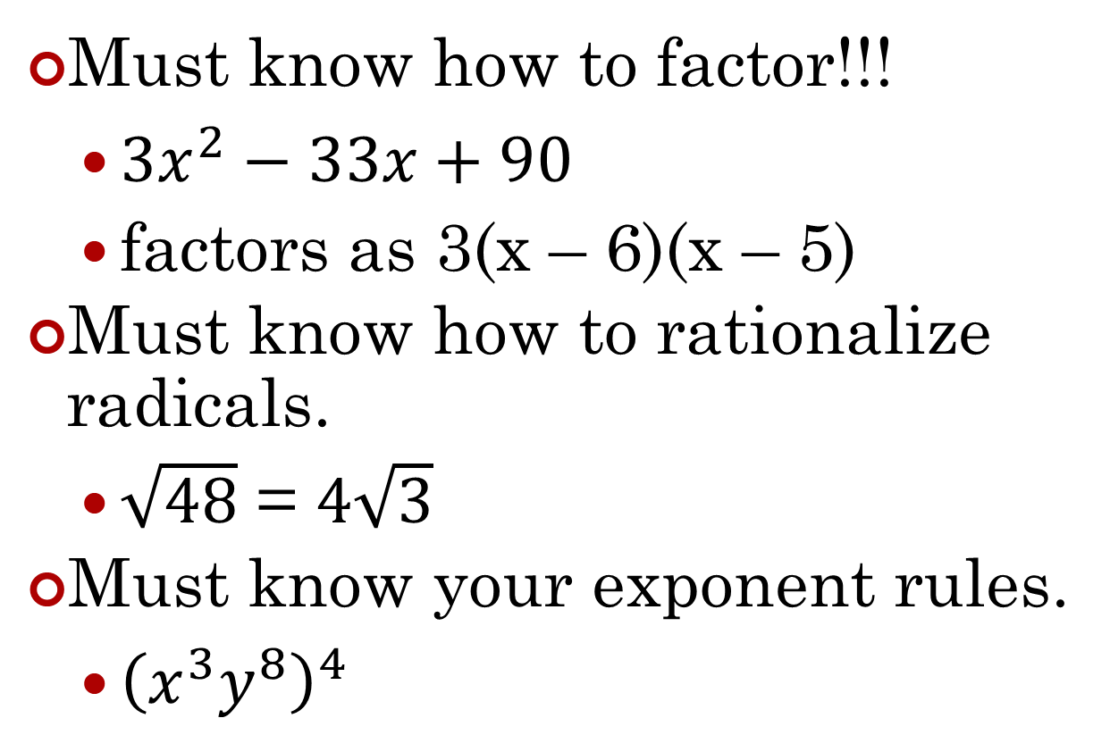
Math Concepts
Must know how to factor!!!
factors as 3(x – 6)(x – 5)
Must know how to rationalize radicals.
=
Must know your exponent rules.

Slide 10
Sample Question
A car averages 27 miles per gallon. If gas costs $4.04 per gallon, which of the following is closest to how much the gas would cost for this car to travel 2,727 typical miles?
A. $ 44.44
B. $109.08
C. $118.80
D. $408.04
E. $444.40
Act.org

Slide 11
Points A, B, C, and D are on a line such that B is between A and C, and C is between B and D. The distance from A to B is 6 units. The distance from B to C is twice the distance from A to B, and the distance from C to D is twice the distance from B to C. What is the distance, in units, from the midpoint of BC to the midpoint of CD ?
F. 18
G. 14
H. 12
J. 9
K. 6
ACT.org

